Slide 1

Predictive Analysis of Gold Prices Using Clustering, Association, and Classification Techniques
Presented by Weiliang Deng, Usama Ahmed, Hossein Yousefi

Slide 2
CONTENT
Introduction
Problem Statement
Clustering
Kmeans
DBSCAN
RANDom Forest
Association
Classification
Apriori
FP-Growth
ECLAT

Slide 3
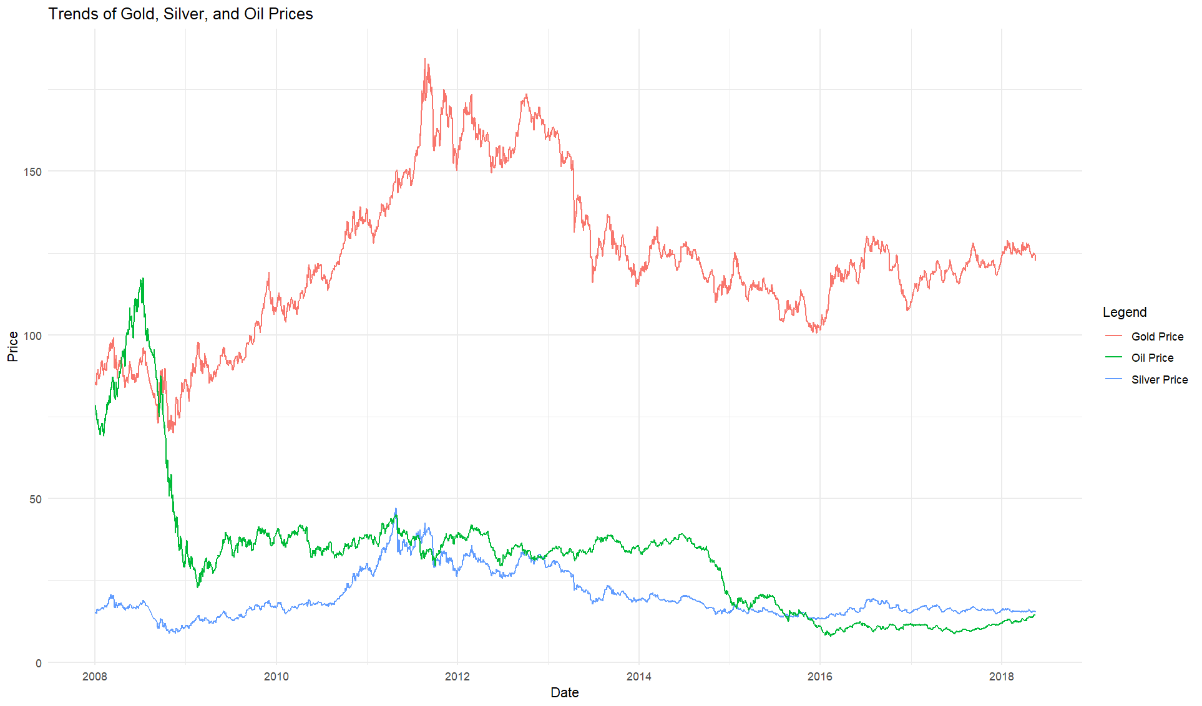
Introduction
Why Gold Prices Matter
$13.2 Trillion Market Cap: Gold represents one of the largest global asset classes.
Global Hedge: Acts as a safe-haven asset during market turmoil (e.g., COVID-19 pandemic).
What is Gold’s Role in Financial Markets?
Hedge against inflation and economic uncertainty.
Significant asset in portfolios and central bank reserves.
Why is Predicting Gold Prices Important?
Informed decision-making for investors.
Strategic risk management for financial institutions.

Slide 4
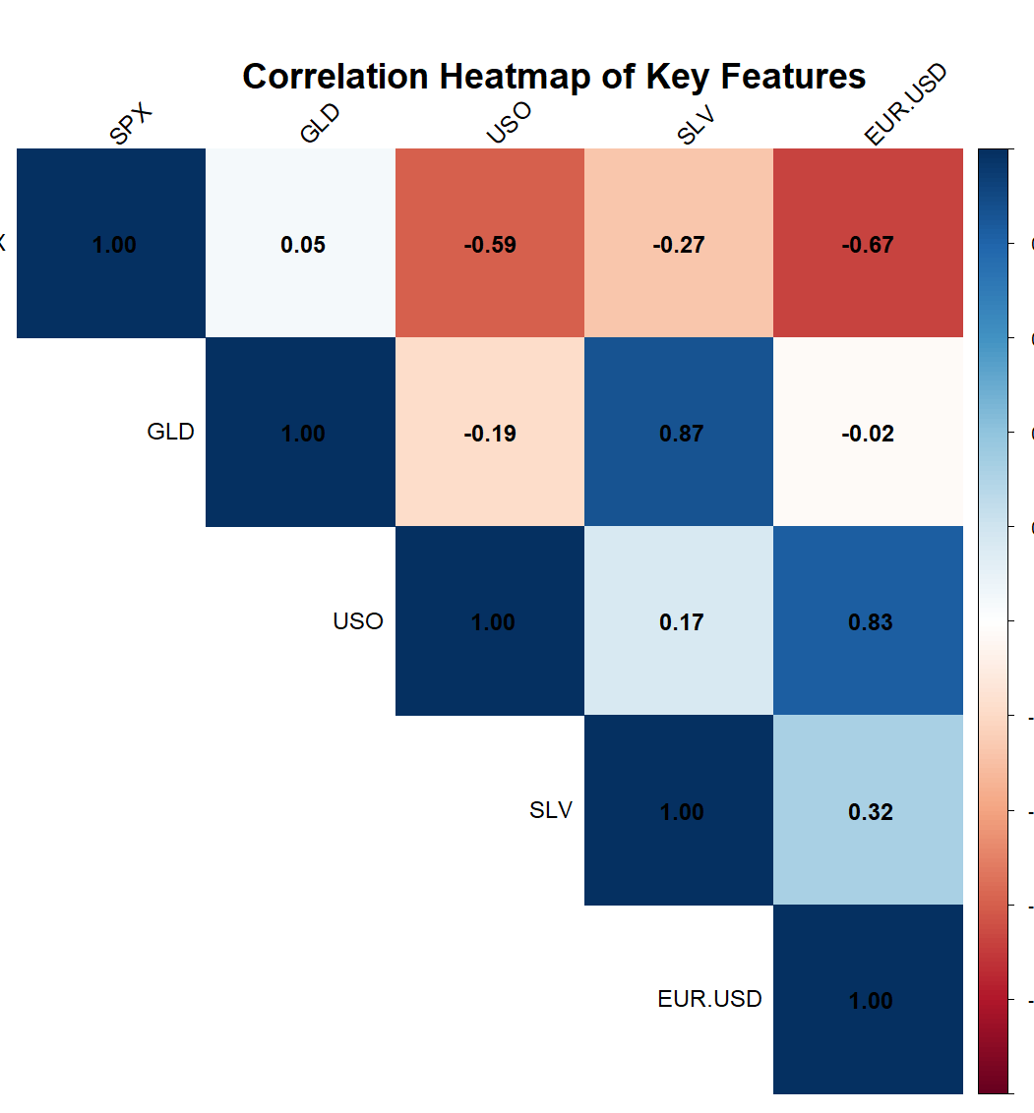
Problem Statement
Challenge:
Gold price movements are driven by complex, interrelated factors, including global economic trends, investor behavior, and geopolitical events.
Key Influencing Factors:
Silver price, oil price, S&P 500 index, EUR/USD exchange rate.
Importance of the Problem:
Gold price movements reflect global market trends.

Slide 5
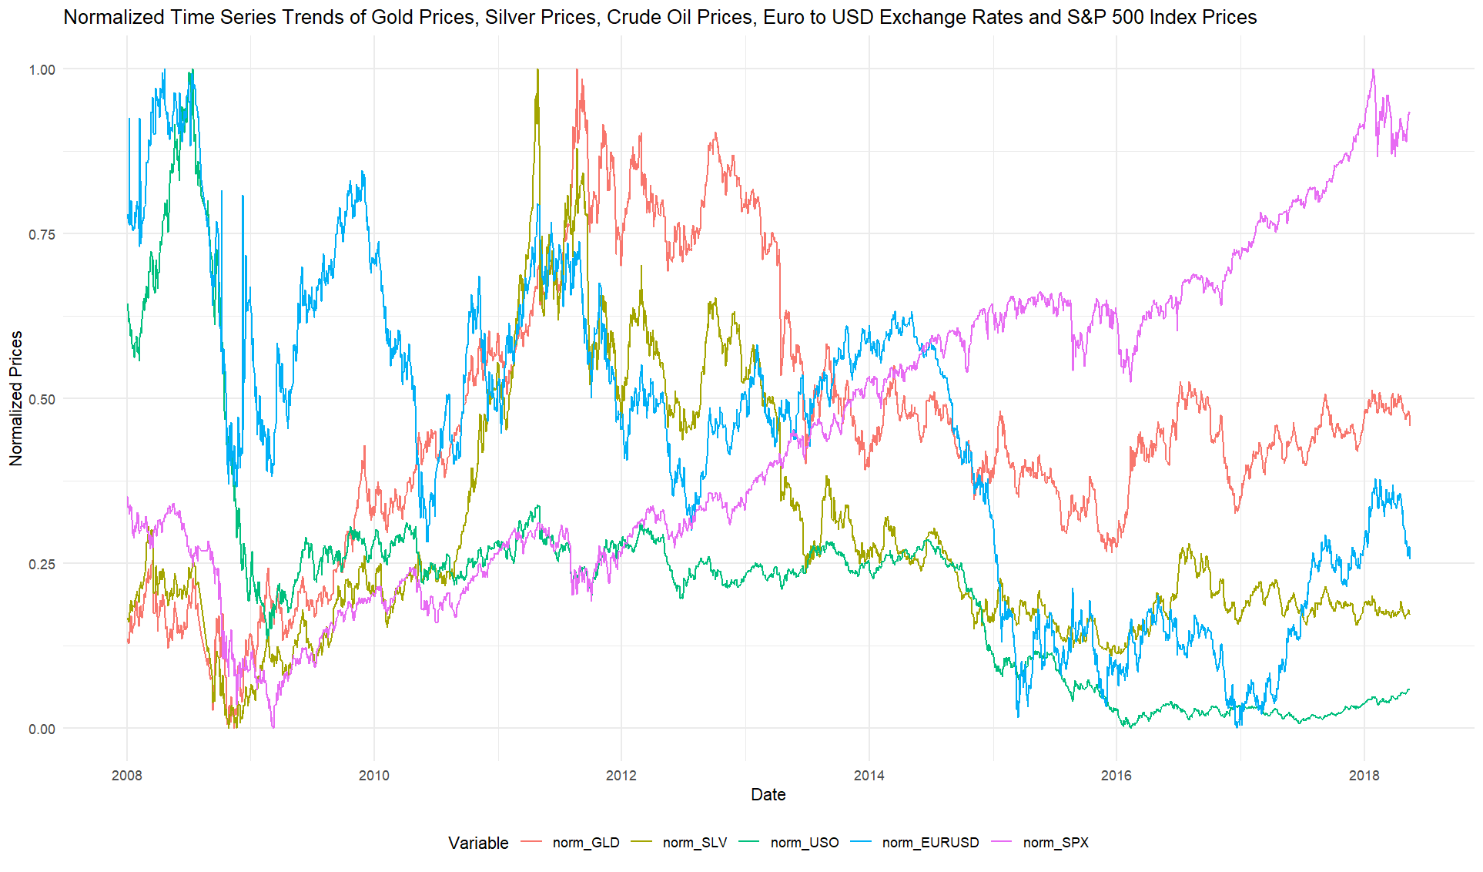
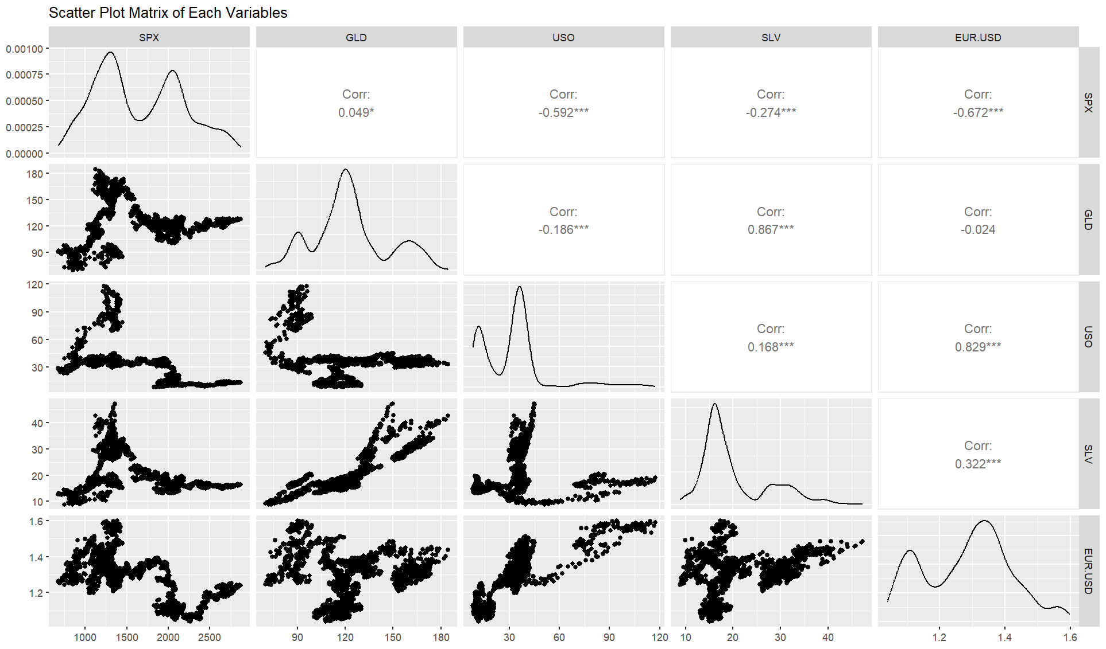
Importance of Features
Key Market Indicators We Analyze:
Silver Price (SLV): Historically, gold and silver exhibit a 90% correlation in price movements.
Oil Price (USO): Rising oil prices increase inflationary pressures, which boosts gold prices as a hedge.
S&P 500 Index (SPX): Inverse relationship – a declining stock market often leads to higher gold demand.
EUR/USD Exchange Rate: Reflects currency strength; a weaker dollar typically drives gold prices higher.

Slide 6

Association

Slide 7
Methods
Algorithm | Efficiency | Best for | Strength | Weakness
Apriori | Moderate (Candidate Generation) | Small to Moderate Datasets | Straightforward implementation | Slow for large datasets due to candidate explo...
FP-Growth | High (FP-Tree) | Large Datasets with Dense Patterns | Compact representation and fast for large data... | Memory intensive for highly sparse datasets
ECLAT | High (Vertical Format) | Sparse Datasets or Large Itemsets | Efficiently handles large itemsets | Limited scalability with very large datasets

Slide 8
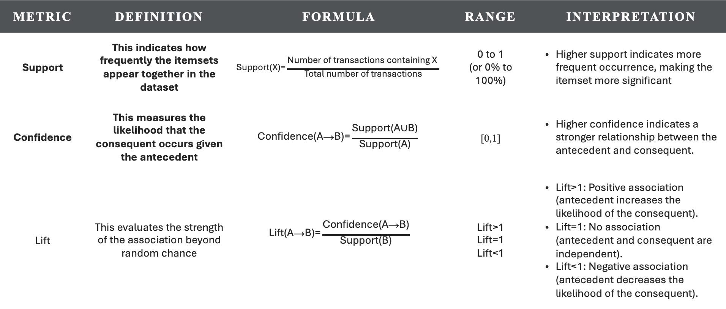
Evaluation
Antecedents & Consequents: itemsets where the "antecedent" leads to the "consequent."
Metric | Definition | Formula | Range | Interpretation
Support | This indicates how frequently the itemsets appear together in the dataset | $$\text{Support}\text{(}\text{X}\text{)=}\frac{\text{Number} \text{of} \text{transactions} \text{containing} \text{X}\text{​ }}{\text{Total} \text{number} \text{of} \text{transactions}}$$ | 0 to 1 (or 0% to 100%) | Higher support indicates more frequent occurrence, making the itemset more significant
Confidence | This measures the likelihood that the consequent occurs given the antecedent | $$\text{Confidence}\text{(}\text{A}\text{→}\text{B}\text{)=}\frac{\text{Support}\text{(}\text{A}\text{∪}\text{B}\text{)}}{\text{Support}\text{(}\text{A}\text{)}}$$ | [0,1] | Higher confidence indicates a stronger relationship between the antecedent and consequent.
Lift | This evaluates the strength of the association beyond random chance | $$\text{Lift}\text{(}\text{A}\text{→}\text{B}\text{)=}\frac{\text{Confidence}\text{(}\text{A}\text{→}\text{B}\text{)}}{\text{Support}\text{(}\text{B}\text{)}}$$ | Lift>1 Lift=1 Lift<1 | Lift>1: Positive association (antecedent increases the likelihood of the consequent). Lift=1: No association (antecedent and consequent are independent). Lift<1: Negative association (antecedent decreases the likelihood of the consequent).

Slide 9
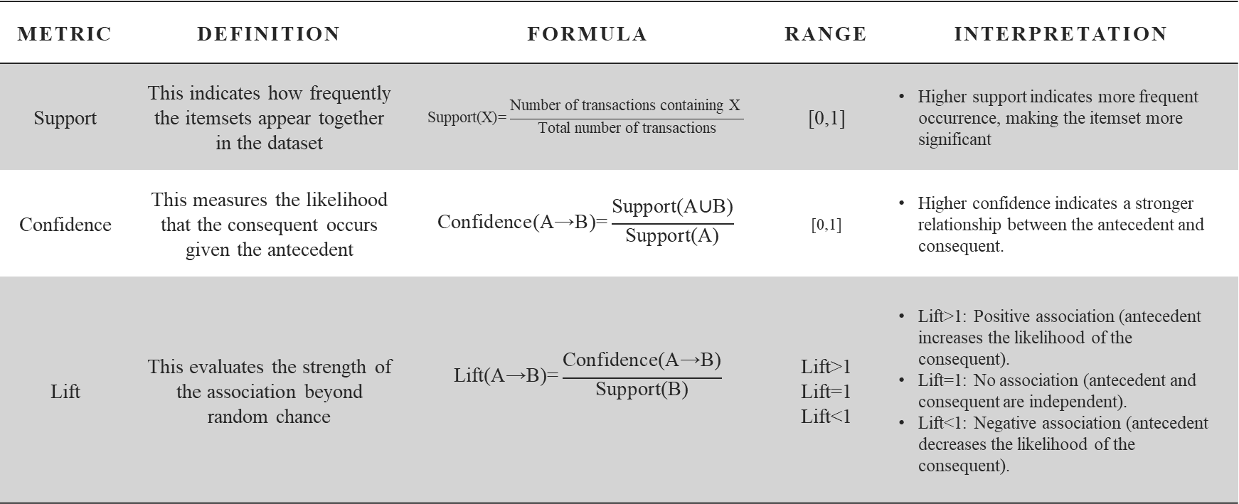
Evaluation
Metric | Definition | Formula | Range | Interpretation
Support | This indicates how frequently the itemsets appear together in the dataset | $$\text{Support}\text{(}\text{X}\text{)=}\frac{\text{Number} \text{of} \text{transactions} \text{containing} \text{X}\text{​ }}{\text{Total} \text{number} \text{of} \text{transactions}}$$ | [0,1] | Higher support indicates more frequent occurrence, making the itemset more significant
Confidence | This measures the likelihood that the consequent occurs given the antecedent | $$\text{Confidence}\text{(}\text{A}\text{→}\text{B}\text{)=}\frac{\text{Support}\text{(}\text{A}\text{∪}\text{B}\text{)}}{\text{Support}\text{(}\text{A}\text{)}}$$ | [0,1] | Higher confidence indicates a stronger relationship between the antecedent and consequent.
Lift | This evaluates the strength of the association beyond random chance | $$\text{Lift}\text{(}\text{A}\text{→}\text{B}\text{)=}\frac{\text{Confidence}\text{(}\text{A}\text{→}\text{B}\text{)}}{\text{Support}\text{(}\text{B}\text{)}}$$ | Lift>1 Lift=1 Lift<1 | Lift>1: Positive association (antecedent increases the likelihood of the consequent). Lift=1: No association (antecedent and consequent are independent). Lift<1: Negative association (antecedent decreases the likelihood of the consequent).

Slide 10
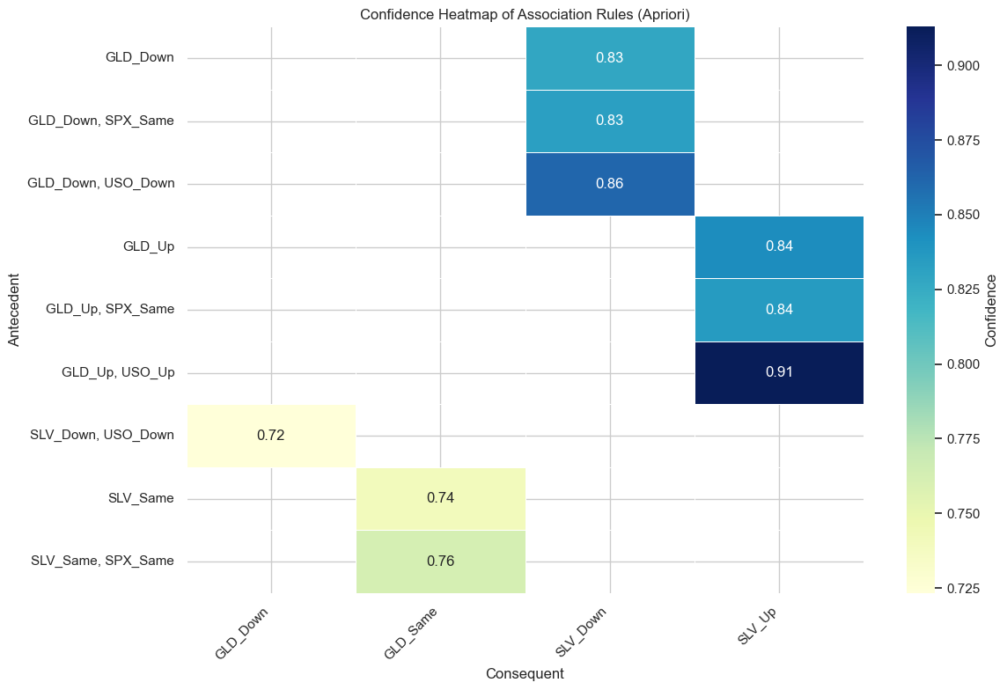
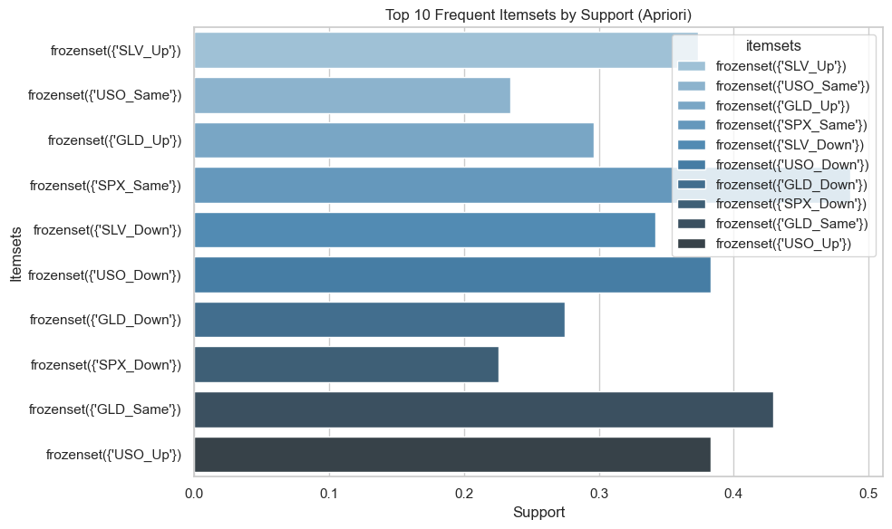
🌀 Apriori
Strongest Rule:
'GLD_Up', 'USO_Up' → 'SLV_Up’:
Confidence: 91.29% (highest confidence).
Lift: 2.444044 (indicates a strong positive association).
Suggests combined upward trends of 'GLD_Up' and 'USO_Up' strongly predict 'SLV_Up’.
Highest Lift:
'USO_Down', 'GLD_Down' → 'SLV_Down’:
Lift: 2.632172 (highest lift).
'SLV_Down' is ~2.63 times more likely when 'USO_Down' and 'GLD_Down' occur.
High Support Rules:
'GLD_Up' → 'SLV_Up’:
Support: 0.249891 (most frequent rule in the dataset).
Most frequent rule, indicating widespread and reliable observation
Summary:
Trends in 'GLD', 'SLV', and 'USO' prices are closely interlinked.
Steps:
Generate Candidate Itemsets
Count Support
Iteratively Expand Itemsets
Prune Non-Frequent Itemsets
Repeat generating and pruning
Generate Association Rules
Configuration:
min_confidence=0.7
min_support=0.1
Itemsets:
44 itemsets are identified
Antecedent | Consequent | Support | Confidence | Lift
'GLD_Up' | 'SLV_Up' | 0.2499 | 0.8437 | 2.2586
'USO_Down', 'SLV_Down' | 'GLD_Down' | 0.1302 | 0.7233 | 2.6322
'GLD_Up', 'USO_Up' | 'SLV_Up' | 0.1328 | 0.9129 | 2.4440

Slide 11
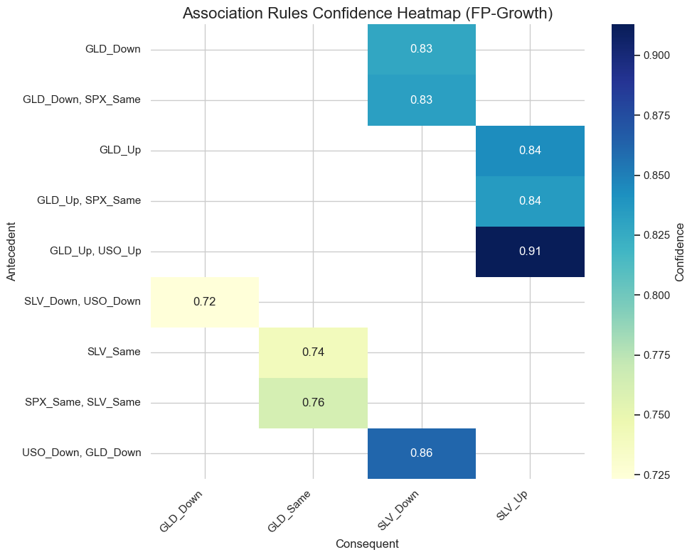
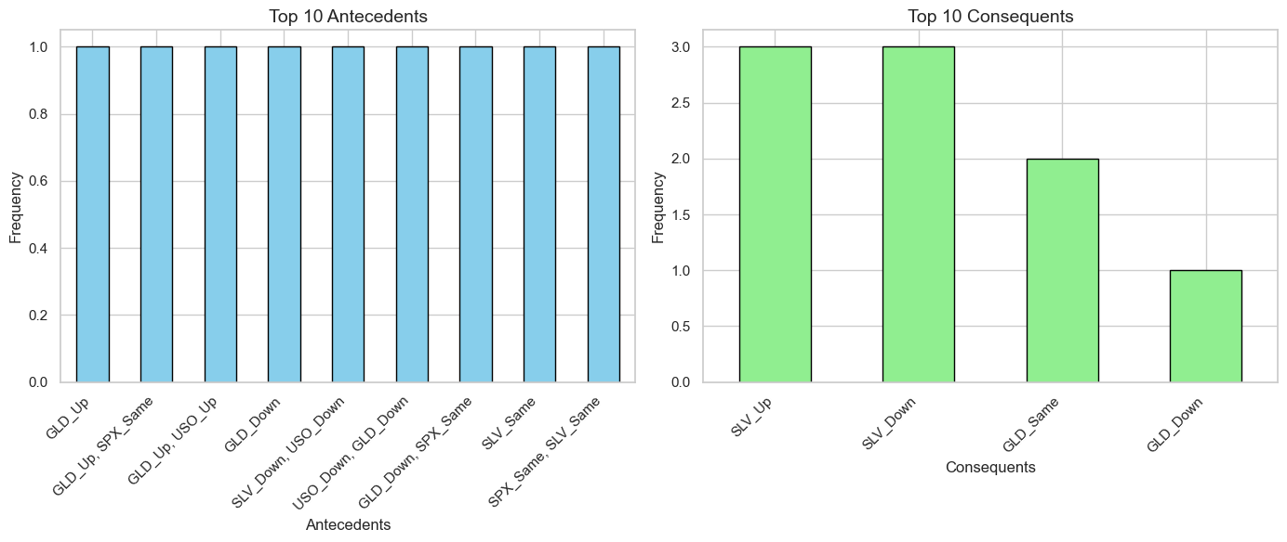
🌀 FP-Growth
Confidence Heatmap: Strong rules include combinations like `GLD_Up → SLV_Up` (0.91) and `GLD_Up, SPX_Same → SLV_Up` (0.84).
Top Antecedents: The bar chart shows evenly distributed top antecedents, indicating that all selected antecedents have similar rule frequencies.
Top Consequents: `SLV_Up` and `SLV_Down` are the most frequent consequents, dominating the rule outcomes, followed by `GLD_Same` and `GLD_Down`.
Summary:
Rules involving `SLV` and `GLD` exhibit strong associations and higher confidence levels, emphasizing their interdependence in the dataset.
Steps:
Construct the FP-Tree
Mine the FP-Tree
Generate Frequent Itemsets
Prune Non-Frequent Itemsets
Stop When Tree is Empty
Generate Association Rules

Slide 12
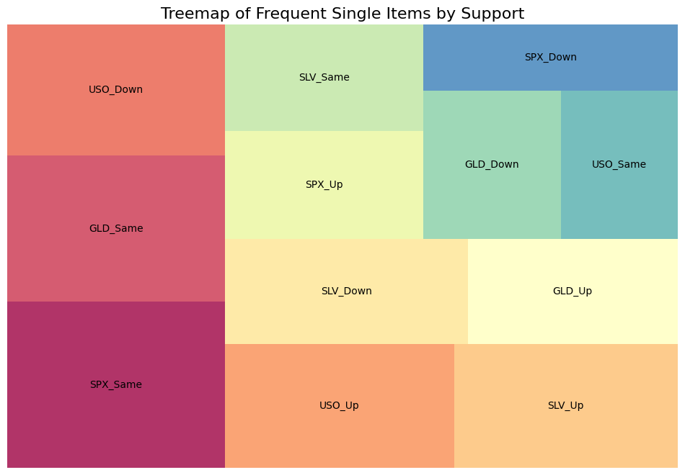
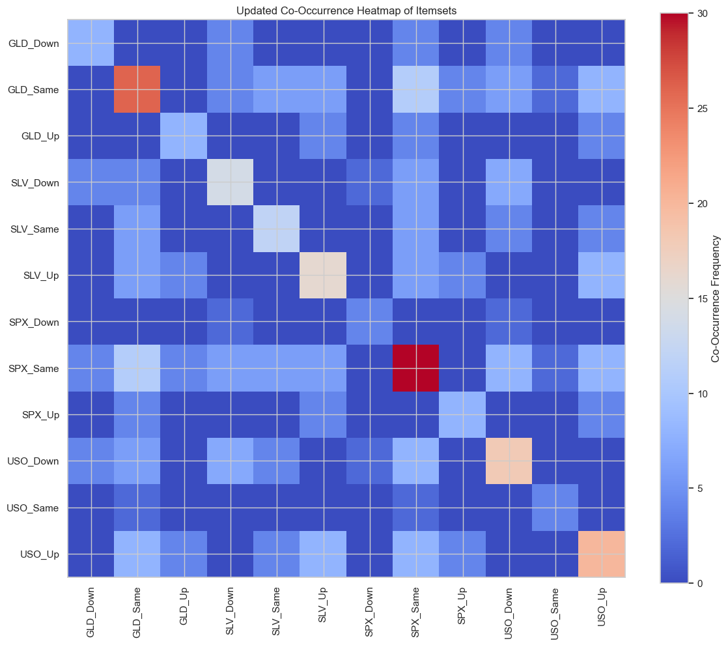
🌀 ECLAT
Steps:
Transform Transactions
Generate Frequent Itemsets
Calculate Support
Prune Non-Frequent Itemsets
Repeat Until Exhausted
Output Frequent Itemsets
Generate Association Rules
Configuration:
min_confidence=0.7
min_support=0.1
Itemsets:
70 itemsets are identified
Summary:
Tile sizes reflect relative occurrence; no single category dominates entirely.
Larger rectangles (e.g., "USO_Down" and "SPX_Down") indicate the most frequent single-item occurrences.
Frequent movements (e.g., "_Down," "_Up," "_Same") highlight trends across assets like USO, SPX, GLD, and SLV.
Antecedent | Consequent | Support | Confidence | Lift
'USO_Same' | 'SPX_Same' | 0.4862 | 2.076 | 4.2705
'GLD_Same', 'USO_Same' | 'SPX_Same' | 0.4862 | 2.076 | 4.2705
'USO_Same' | 'SPX_Same', 'GLD_Same' | 0.4862 | 2.076 | 4.2705

Slide 13
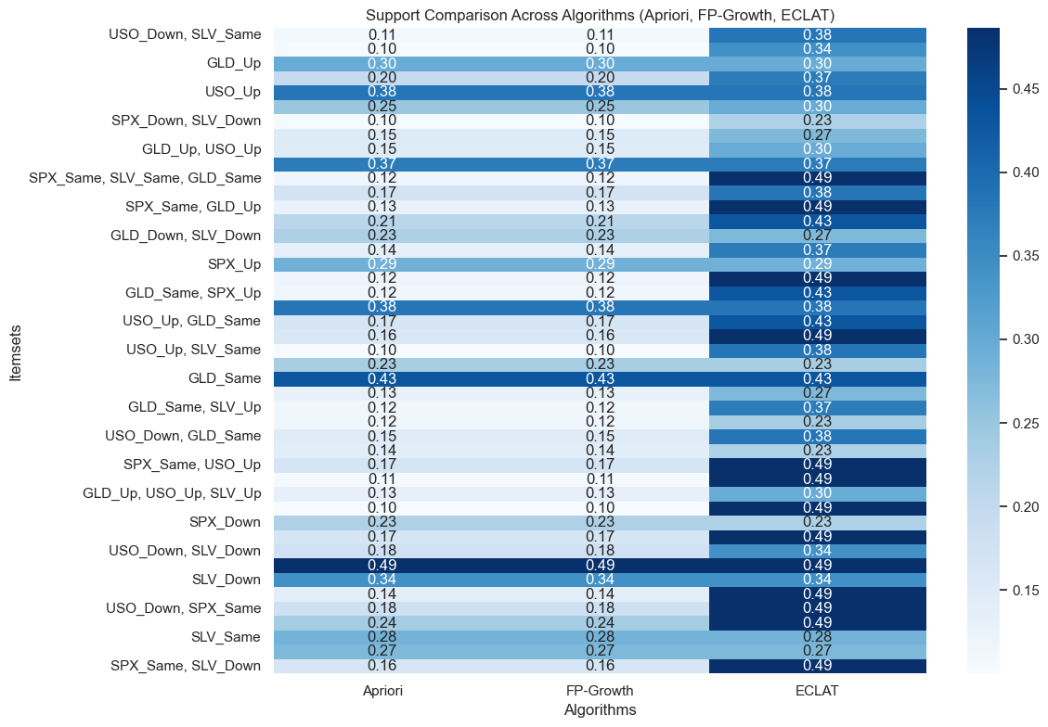
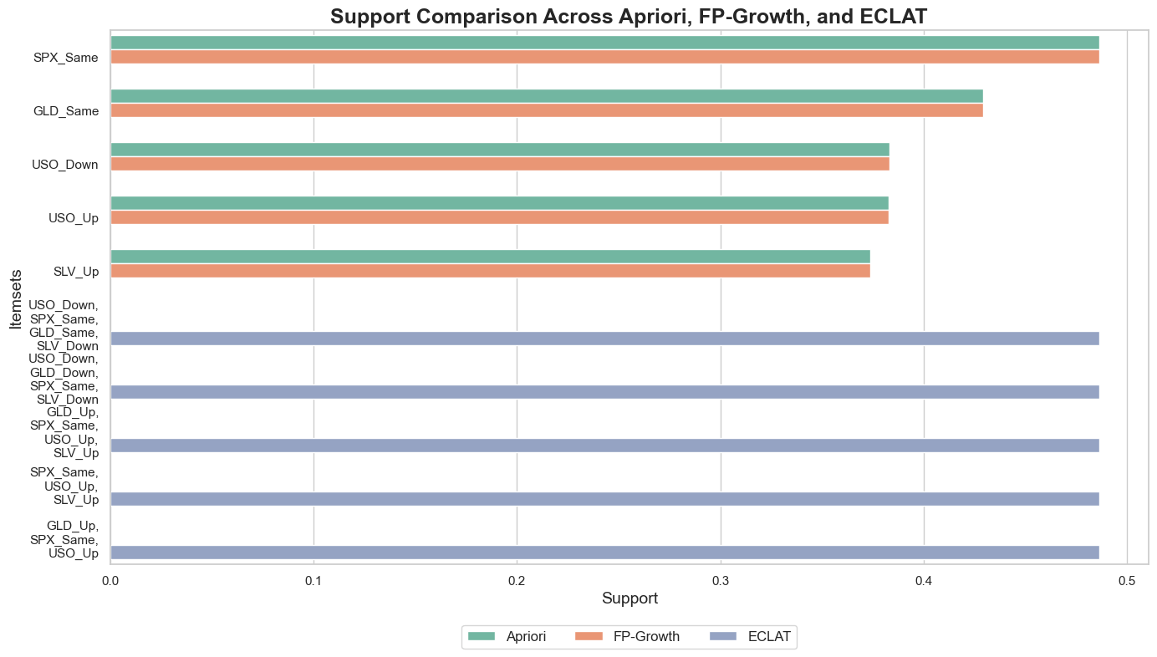
📊 Results
Investment Suggestions Based on Results
Focus on Stability:
SPX_Same (~43% support): Invest in S&P 500 index funds during stable market conditions.
GLD_Same (~30% support): Use gold or gold-backed ETFs as a hedge during volatility.
Leverage Multi-Item Associations:
GLD_Up, SLV_Up, USO_Up (~37% support): Invest in gold, silver, and oil during synchronized uptrends.
USO_Down, SPX_Same: Shift to equities in energy-sensitive sectors during oil price declines.
Diversify Assets:
Combine equities (SPX_Up) and gold (GLD_Same) for risk-adjusted returns.Add silver (SLV_Up) as a complementary asset to gold.
Hedge Against Risk:
Use gold's stability to protect against market downturns while staying invested in stocks.
Timing Strategies:
Monitor synchronized movements in commodities (e.g., {GLD_Up, SLV_Up, USO_Up}) for actionable entry points
Notes:
ECLAT consistently captures higher support for multi-item itemsets, confirming its efficiency in finding complex patterns.
Simple itemsets (GLD_Same, SLV_Up) have similar support across all algorithms, reflecting their robustness in frequency.
The top itemsets (SPX_Same, GLD_Same, SLV_Up, etc.) have consistent support values across algorithms.
ECLAT captures more frequent and larger itemsets, which may be due to its efficient handling of vertical data representation.
For itemsets involving multiple items, ECLAT identifies higher support values than Apriori and FP-Growth.

Slide 14

Clustering
Notes:
What is Clustering?
"Clustering is an unsupervised machine learning technique that groups similar data points to uncover hidden patterns.”
Project Goal
"Apply KMeans, DBSCAN, and Random Forest Clustering to identify meaningful clusters, evaluate their quality with metrics like the Silhouette Score and Davies-Bouldin Index, and visualize the results using PCA."

Slide 15
Methods
Method | Description | Key Parameters | Strengths | Weaknesses
KMeans | Partitions the data into k clusters by minimizing the variance within each cluster. Centers are iteratively updated to achieve the best partition. | Number of clusters (k). | Simple, fast, and works well with spherical clusters. | Sensitive to initial centroids and requires pre-specifying the number of clusters.
DBSCAN | Density-based method that groups points closely packed together while labeling low-density points as noise | eps (neighborhood radius), min_samples | Finds clusters of arbitrary shapes, robust to noise, and does not require specifying the number of clusters. | Struggles with varying density and requires careful tuning of eps and min_samples.
Random Forest Clustering | Uses a proximity matrix from Random Forest decision trees to group points based on shared paths in decision trees (unsupervised adaptation). | Number of trees in RF, distance threshold. | Handles complex structures, interpretable, and adaptable to multiple data types. | Computationally intensive, depends on synthetic labels, and indirect compared to direct clustering.
*** PCA applied to all methods.
Notes:
"Here’s a quick overview of the clustering methods we used, including their key points.”
1. KMeans
Description: Groups data into k clusters by minimizing variance.
Key Parameter: k (Number of clusters).
Strengths: Simple, fast, and effective for spherical clusters.
Weaknesses: Requires specifying k and is sensitive to initial centroids.
2. DBSCAN
Description: A density-based method that identifies dense clusters and labels outliers as noise.
Key Parameters: eps (Neighborhood radius) and min_samples.
Strengths: Finds clusters of any shape and handles noise well.
Weaknesses: Requires careful tuning of eps and min_samples.
3. Random Forest Clustering
Description: Uses a proximity matrix from decision trees to cluster data.
Key Parameters: Number of trees and distance threshold.
Strengths: Handles complex structures and is interpretable.
Weaknesses: Computationally intensive and depends on synthetic labels.
We applied PCA to all methods for easier visualization.

Slide 16
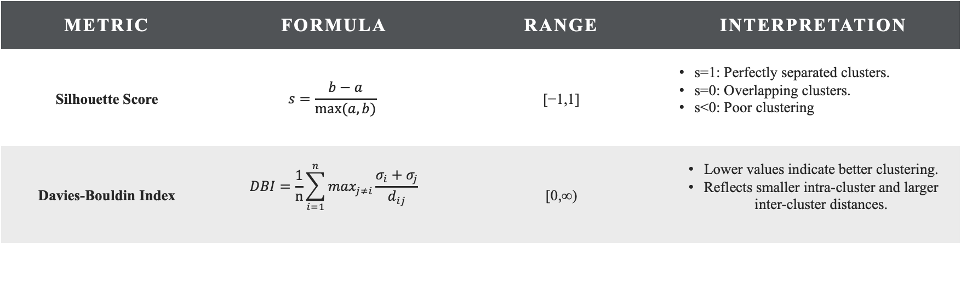
Evaluation
Metric | Formula | Range | Interpretation
Silhouette Score | $$s=\frac{b−a}{max⁡(a,b)}$$ | [−1,1] | s=1: Perfectly separated clusters. s=0: Overlapping clusters. s<0: Poor clustering
Davies-Bouldin Index | $$DBI=\frac{1}{n}\sum_{i=1}^{n}{\max_{j≠i}\frac{σ_{i}+σ_{j}}{d_{ij}}}$$ | [0,∞) | Lower values indicate better clustering. Reflects smaller intra-cluster and larger inter-cluster distances.
Notes:
These metrics help us understand how well the data points are grouped into clusters and how distinct the clusters are from each other.

Slide 17
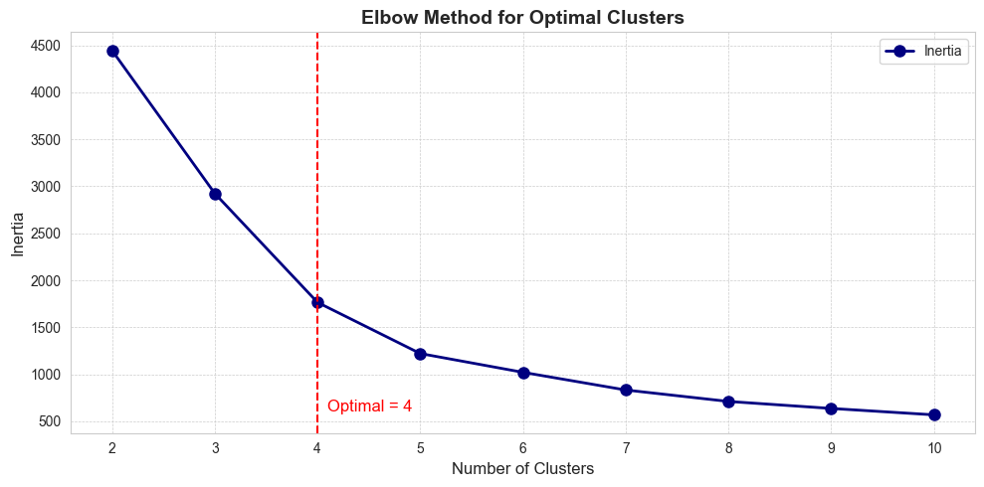
🌀 KMeans Method
Clustering Algorithm:
KMeans Clustering is used to group the data into distinct clusters.
Goal:
Identify the optimal number of clusters by observing where the inertia (sum of squared distances to cluster centers) decreases significantly.
Elbow Method:
Plot Inertia vs. Number of Clusters.
Notes:
Clustering Algorithm:
KMeans groups data into distinct clusters by minimizing the variance within each cluster.
Goal:
Identify the optimal number of clusters by analyzing the inertia (sum of squared distances to cluster centers).
Elbow Method:
We plotted Inertia vs. Number of Clusters.
The elbow point occurs at 4 clusters, where the inertia curve starts to flatten.
This suggests that 4 clusters is the optimal choice.
"On the right, you can see the elbow point marked with a red dashed line, clearly showing where adding more clusters stops significantly reducing inertia."

Slide 18
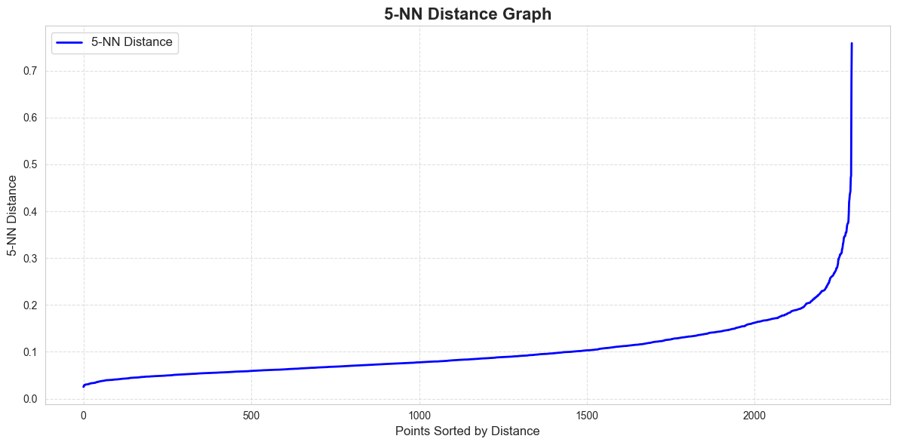
🧭 DBSCAN Method
Purpose:
Identify the optimal eps (epsilon) parameter for DBSCAN, which determines the neighborhood size for clustering.
5-NN Distance Calculation:
For each data point, calculate the distance to its 5th nearest neighbor.
Sort these distances in ascending order.
Key Observations:
The elbow point appears where the distances start to rise steeply.
In this graph, the sharp bend happens approximately around 0.2 to 0.3 on the Y-axis.
Notes:
This slide explains how we used the DBSCAN method to identify clusters by determining the optimal eps (epsilon) parameter.”
Purpose:
The goal is to find the optimal eps value, which controls the neighborhood size for clustering.
5-NN Distance Calculation:
For each data point, we calculate the distance to its 5th nearest neighbor.
These distances are then sorted in ascending order.
Key Observations:
The elbow point on the 5-NN Distance Graph indicates where the distances start to rise steeply.
In our graph, the sharp bend happens between 0.2 and 0.3 on the Y-axis. This helps us determine a suitable eps value for DBSCAN.
By selecting eps around this elbow point, we ensure that DBSCAN can effectively identify clusters and distinguish noise.

Slide 19
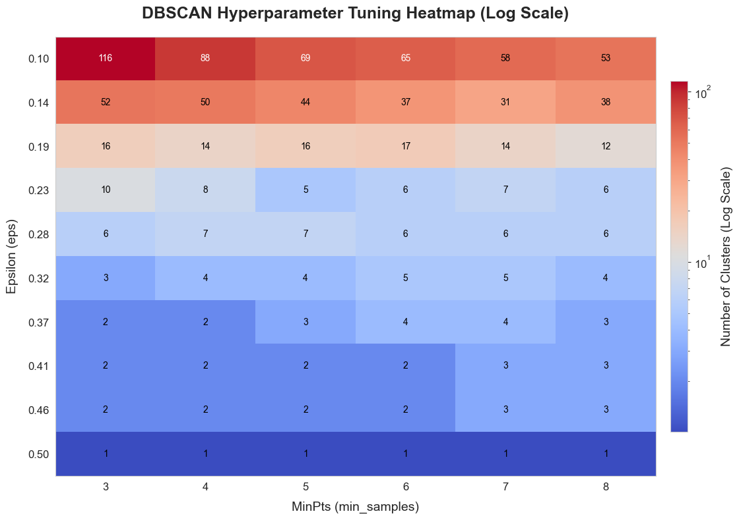
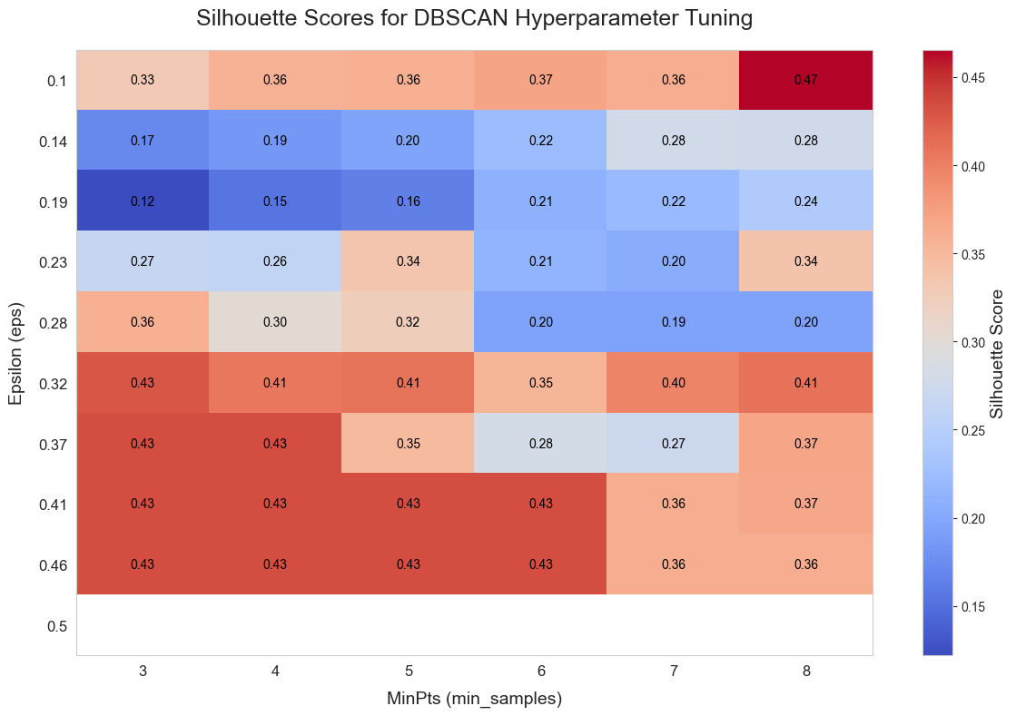
🧭 DBSCAN Method
Notes:
This slide shows the results of DBSCAN hyperparameter tuning using eps and min_samples. The heatmap on the left displays the number of clusters detected for different combinations of eps and min_samples. In this heatmap, red areas indicate more clusters, while blue areas indicate fewer clusters. We observe that smaller eps values and lower min_samples produce more clusters, while larger eps values result in fewer clusters.
The heatmap on the right shows the Silhouette Scores, which measure clustering quality. Higher scores, shown in red, indicate better-defined clusters. The best scores are achieved with eps between 0.3 and 0.37 and min_samples between 4 and 6. By combining these insights, we can select the optimal parameters for DBSCAN to balance the number of clusters and clustering quality.

Slide 20
🧩 Random Forest Clustering with Top Features
Model Details
Clustering Algorithm:
Random Forest Classifier trained with synthetic labels from Agglomerative Clustering.
Number of Clusters:
4 Clusters were defined for the clustering process.
Steps Involved:
Generate Synthetic Labels using Agglomerative Clustering.
Train Random Forest to determine feature importance.
Compute Proximity Matrix from the Random Forest.
Apply Hierarchical Clustering using the Proximity Matrix.
Feature Selection
Selected Features:
The top 2 features selected based on their importance are:
norm_SLV (Normalized Silver Price)
norm_USO (Normalized Crude Oil Price)
Feature Importance:
Feature importance was derived from the Random Forest classifier trained on all features.
Notes:
In this slide, we outline the Random Forest Clustering process and the selected features.
We used a Random Forest Classifier with synthetic labels from Agglomerative Clustering to define 4 clusters. The steps involved were:
Generate synthetic labels using Agglomerative Clustering.
Train Random Forest to determine feature importance.
Compute the proximity matrix from the Random Forest.
Apply Hierarchical Clustering using this matrix.
For feature selection, the top 2 features identified were norm_SLV (Normalized Silver Price) and norm_USO (Normalized Crude Oil Price). These features were chosen based on their importance scores from the Random Forest model.
This process helped us identify key features driving the clustering results.

Slide 21
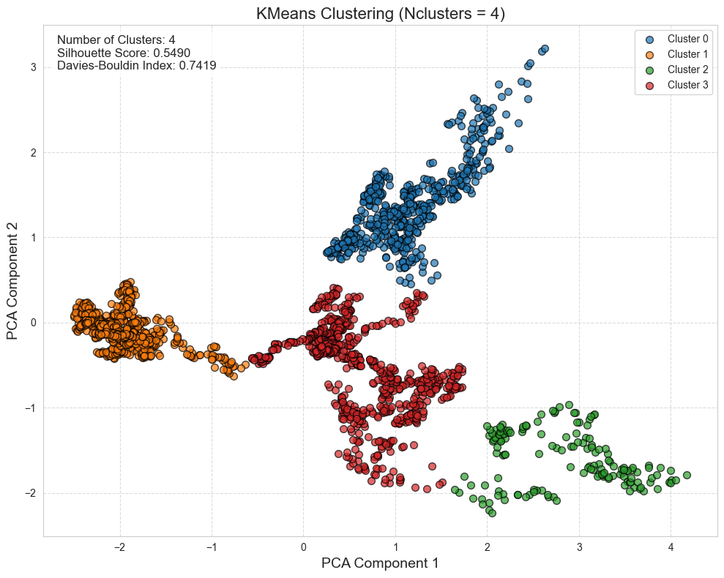
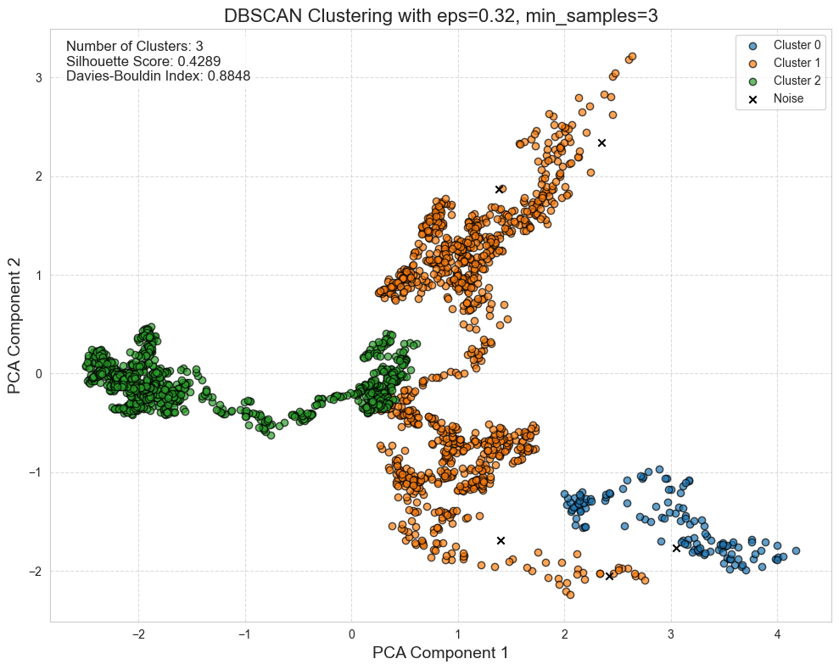
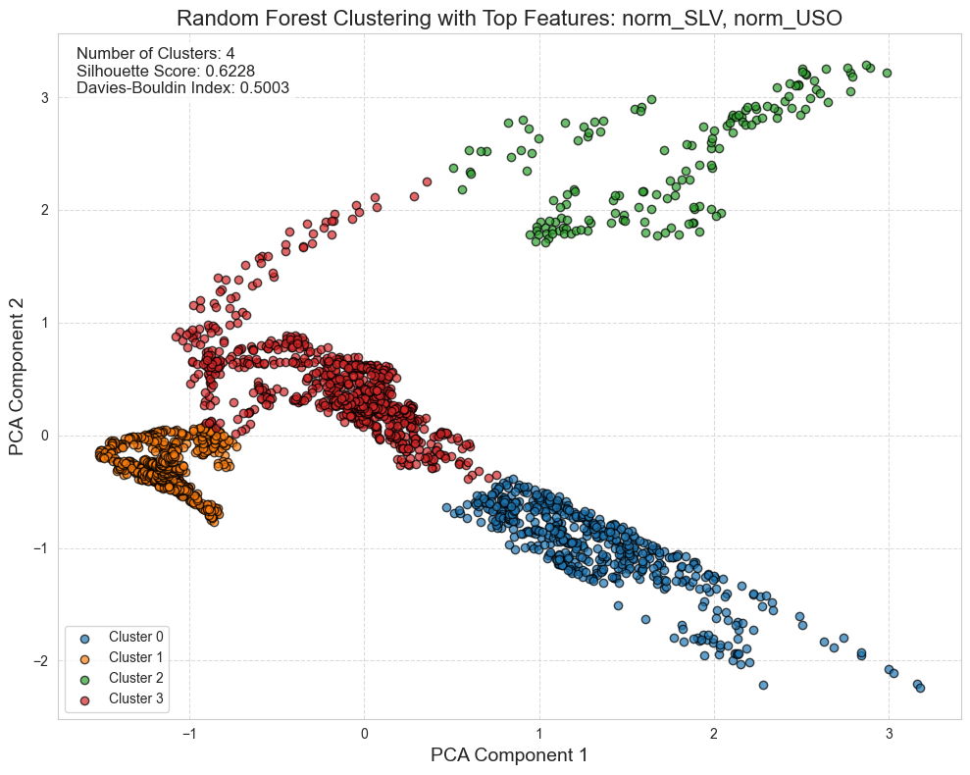
📊 Results
Notes:
This slide presents the clustering results for the three methods we used: KMeans, DBSCAN, and Random Forest Clustering. Each plot shows the clusters visualized using PCA components.
showing results and talking about results for others. Based on the results, Random Forest Clustering achieved the highest Silhouette Score and the lowest Davies-Bouldin Index, indicating the best clustering performance. Therefore, Random Forest Clustering is the most suitable method for this dataset, as it captures complex relationships and produces well-defined clusters.

Slide 22

Classification

Slide 23
Methods
Method | Description | Key Parameters | Strengths | Weaknesses
Random Forest | An ensemble method that builds multiple decision trees and combines their outputs to improve accuracy and reduce overfitting. | Number of trees Max tree depth | Robust to overfitting due to averaging/voting mechanism. | Computationally intensive with a large dataset or many trees.
SVM | A supervised learning method that finds the optimal hyperplane to separate data points into different classes, maximizing the margin between classes. | Kernel type Regularization - Parameter | Effective in high-dimensional spaces. | Struggles with overlapping classes or noisy data.
Naïve Bayes Classifier | A probabilistic classifier based on Bayes' Theorem, assuming independence between features. | Distribution Type | Simple and fast to implement. | Less effective with complex feature interactions.

Slide 24
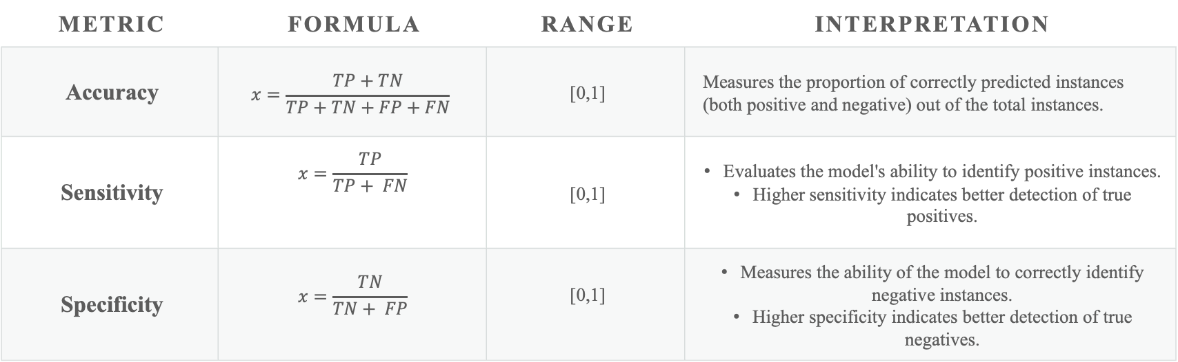
Evaluation
Metric | Formula | Range | Interpretation
Accuracy | $$x=\frac{TP+TN}{TP+TN+FP+FN}\text{​}$$ | [0,1] | Measures the proportion of correctly predicted instances (both positive and negative) out of the total instances.
Sensitivity | $$x=\frac{TP}{TP+ FN}\text{​}$$ | [0,1] | Evaluates the model's ability to identify positive instances. Higher sensitivity indicates better detection of true positives.
Specificity | $$x=\frac{TN}{TN+ FP}\text{​}$$ | [0,1] | Measures the ability of the model to correctly identify negative instances. Higher specificity indicates better detection of true negatives.

Slide 25
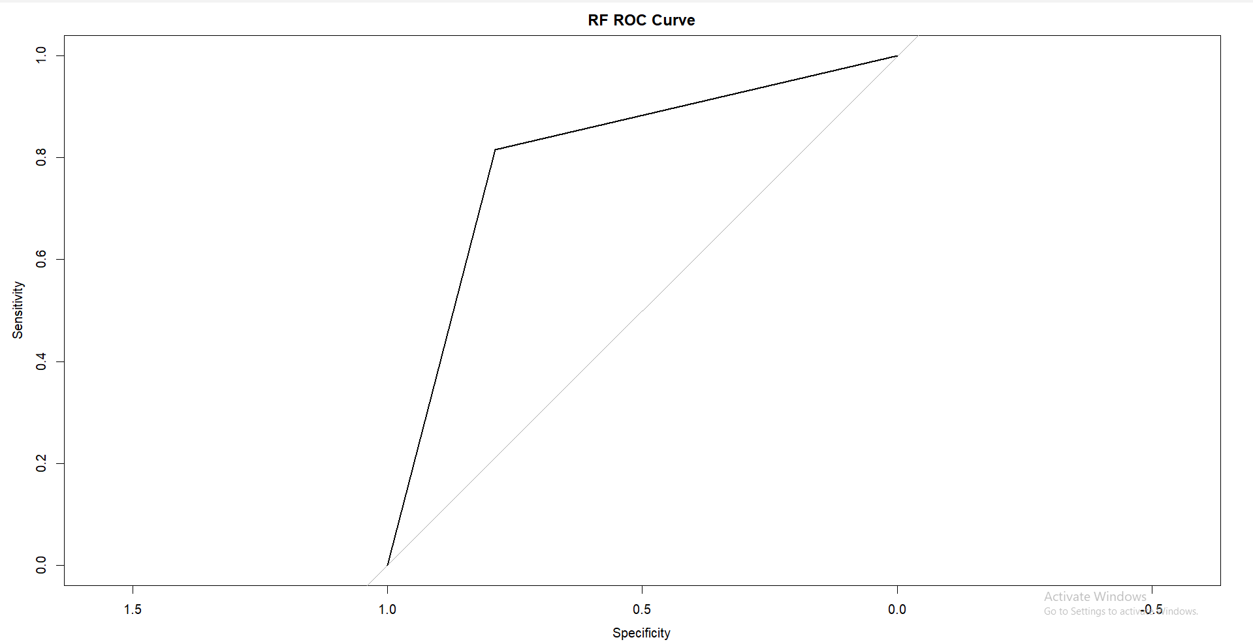
Random Forest
Performance Evaluation:
The ROC curve shows that the model performs moderately well, as it deviates from the diagonal (random chance) and approaches the top-left corner, though not perfectly. This indicates that the classifier can distinguish between the two classes but with room for improvement.
Imbalanced Predictions:
The overall pattern suggests potential struggles with imbalanced data or overlapping class distributions, as the curve does not reach close to the ideal top-left point. Further tuning or rebalancing might be necessary for improved results.

Slide 26
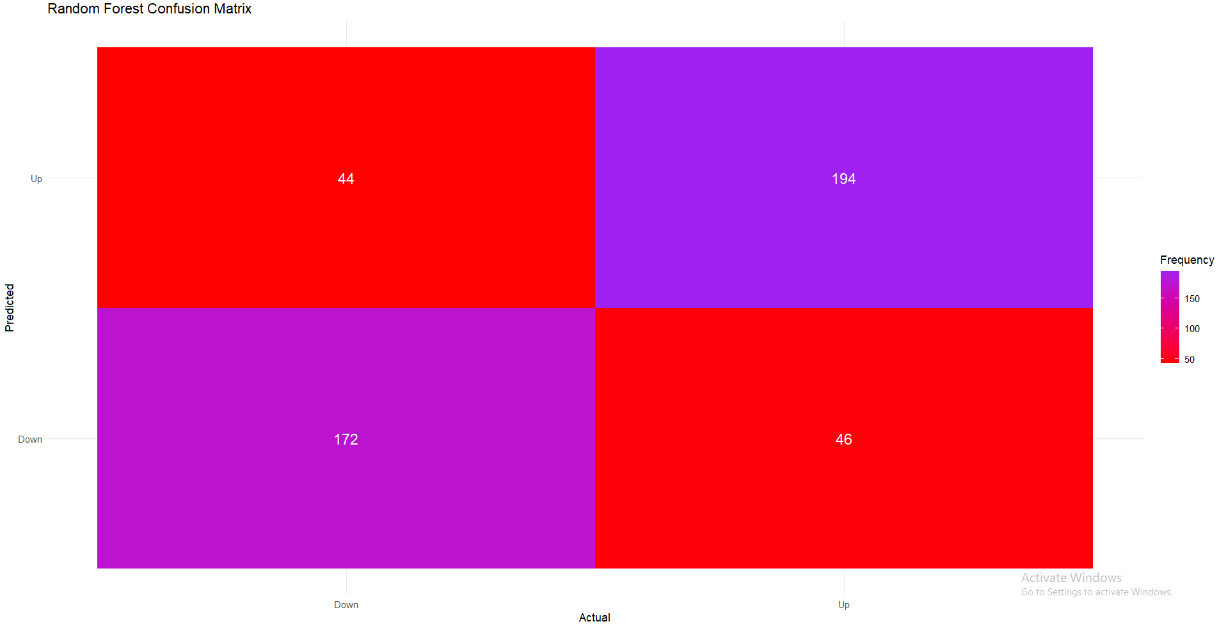
Random Forest
Classification Accuracy:
The model correctly predicted "Up" 44 times (true positives) and "Down" 46 times (true negatives). However, it misclassified "Up" as "Down" 194 times (false negatives) and "Down" as "Up" 172 times (false positives). The high number of misclassifications indicates the model struggles to correctly distinguish between the two classes.
Class Imbalance Impact:
The disproportionate number of false positives and false negatives suggests that the model may not perform well on balanced or imbalanced datasets and may require further tuning or additional data preprocessing to improve its classification capability

Slide 27
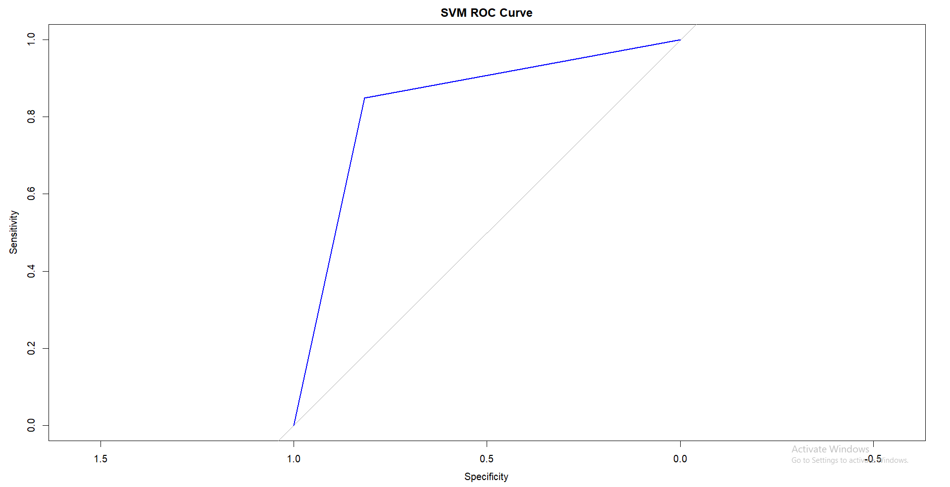
Support Vector Machines (SVM)
Performance Evaluation:
The ROC curve demonstrates moderate performance, with a noticeable deviation from the diagonal line (random chance). While it does not perfectly reach the top-left corner, it shows a reasonable ability to distinguish between the two classes, indicating moderate classification quality.
Imbalanced Predictions:
The curve’s shape indicates challenges with imbalanced data, as the model does not achieve ideal sensitivity and specificity trade-offs. This suggests that further hyperparameter tuning or handling class imbalance may improve performance.

Slide 28
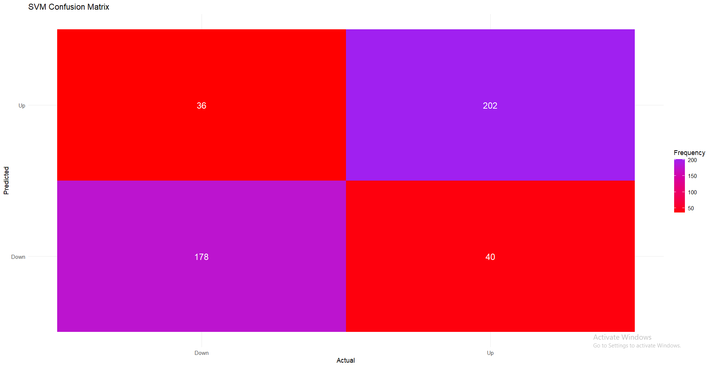
Support Vector Machines (SVM)
Classification Accuracy:
The SVM model correctly predicted "Up" 36 times (true positives) and "Down" 40 times (true negatives). However, it misclassified "Up" as "Down" 202 times (false negatives) and "Down" as "Up" 178 times (false positives). The high misclassification rates indicate the model struggles significantly with distinguishing between the two classes.
Class Imbalance Impact:
The large discrepancy between true and false predictions highlights the model's difficulty handling imbalanced datasets. Additional data preprocessing, better parameter tuning, or alternative techniques might be required.

Slide 29
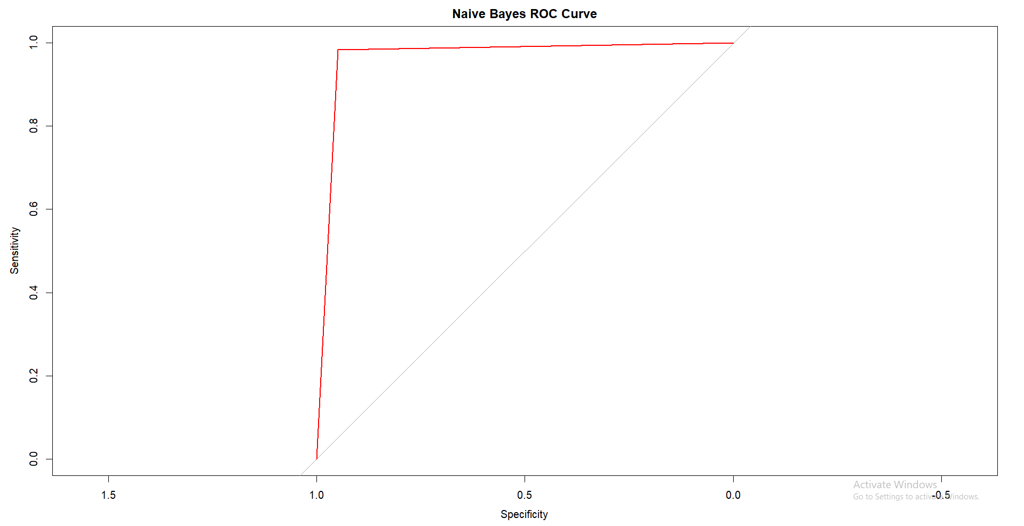
Naïve Bayes Classifier
Performance Evaluation:
The ROC curve for Naïve Bayes nearly approaches the ideal top-left corner, demonstrating strong performance. The model effectively distinguishes between the two classes, showcasing high sensitivity and specificity.
Imbalanced Predictions:
The curve's proximity to the top-left corner suggests that the model handles imbalanced data or class overlaps relatively well. However, further validation with the confusion matrix is needed to confirm.

Slide 30
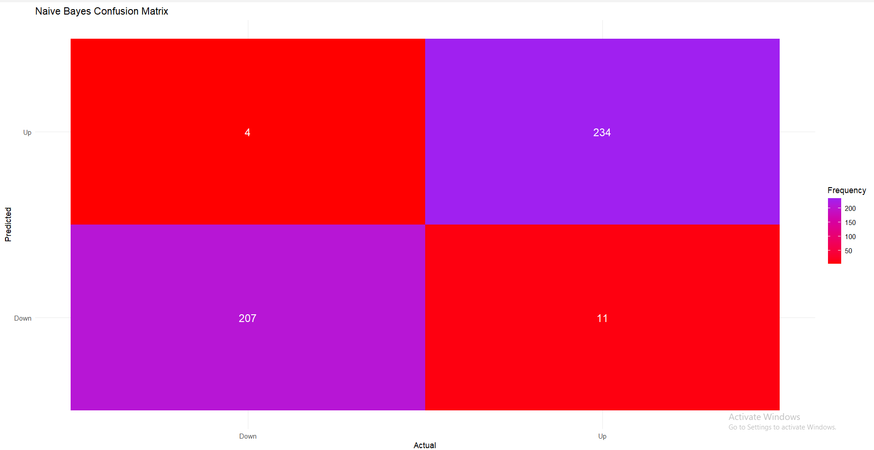
Naïve Bayes Classifier
Classification Accuracy:
The Naïve Bayes model correctly predicted "Up" 4 times (true positives) and "Down" 11 times (true negatives). However, it misclassified "Up" as "Down" 234 times (false negatives) and "Down" as "Up" 207 times (false positives). This reflects very poor predictive performance, with most predictions being incorrect.
Class Imbalance Impact:
The extreme imbalance in predictions indicates that the model fails to generalize effectively, likely due to the strong independence assumptions of Naïve Bayes. Addressing feature dependence or selecting a different model may be necessary to improve results.

Slide 31
Conclusion
 | Random Forest | Support Vector Machines | Naïve Bayes Classifier
Accuracy | 80.26% | 83.33% | 96.71%
Sensitivity | 78.90% | 81.65% | 94.95%
Specificity | 81.51% | 84.87% | 98.32%
Naive Bayes performed the best in terms of all metrics, likely benefiting from its probabilistic nature and strong independence assumptions.
SVM showed strong performance, particularly in terms of specificity, making it a robust option for datasets with balanced class distributions.
Random Forest performed well overall but may require further tuning or additional features to improve sensitivity.

Slide 32

Thank you for your time and attention! I’m happy to answer any questions you may have.

